Slide 1
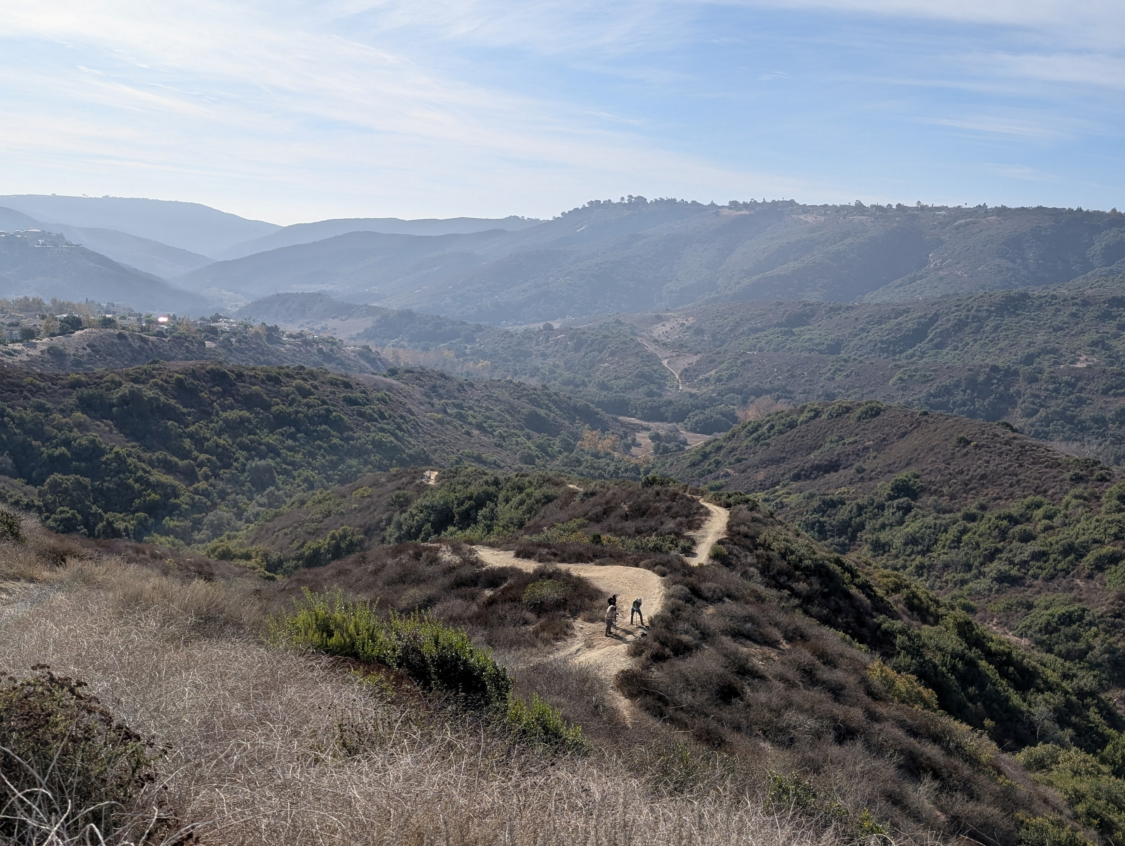

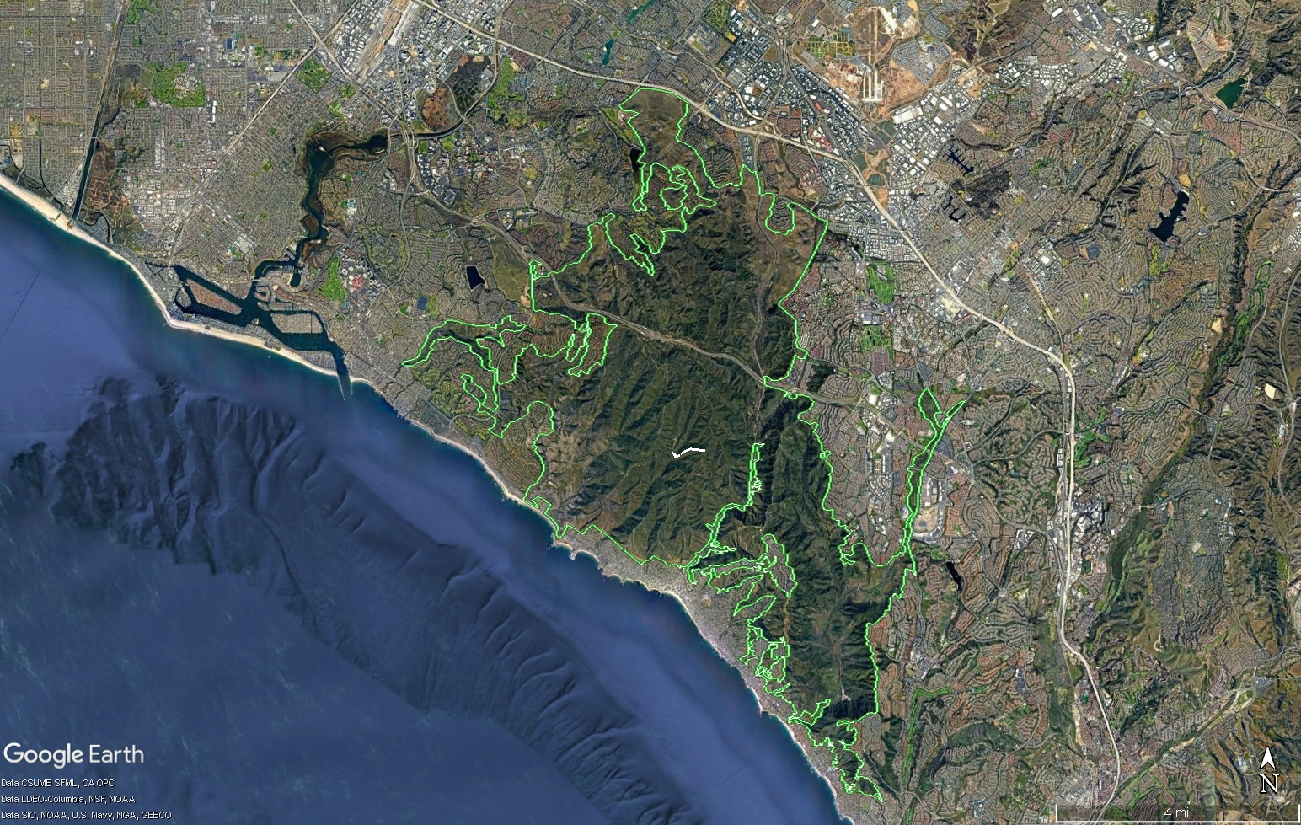
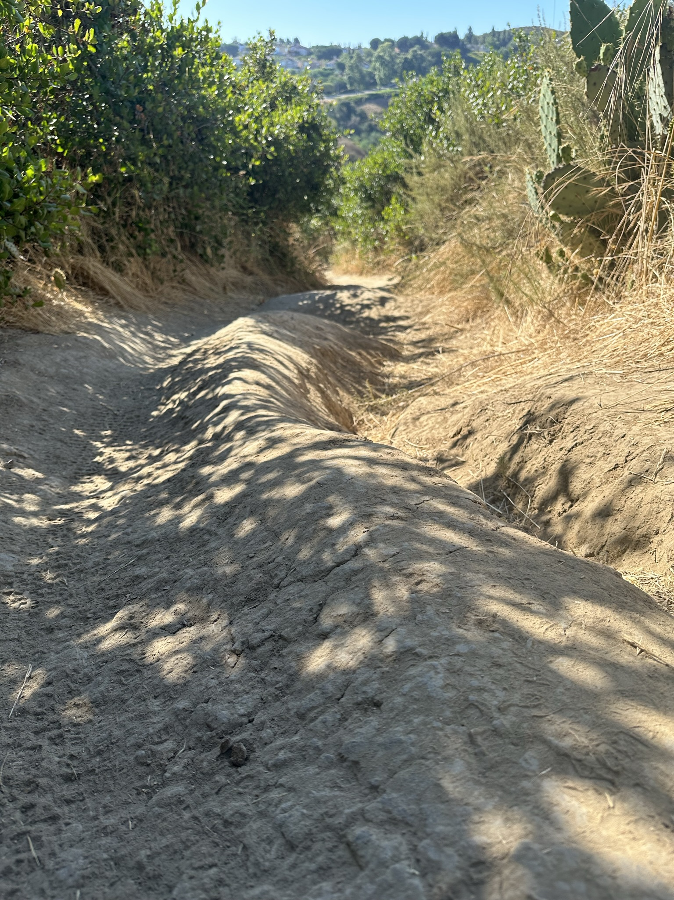
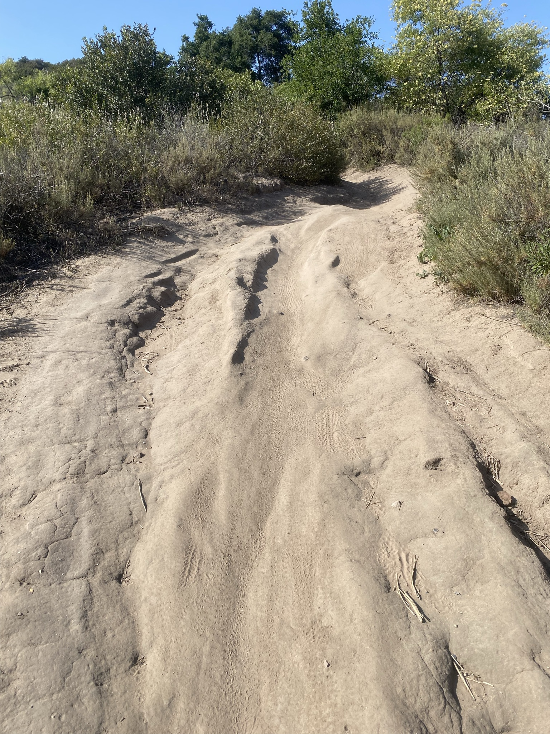
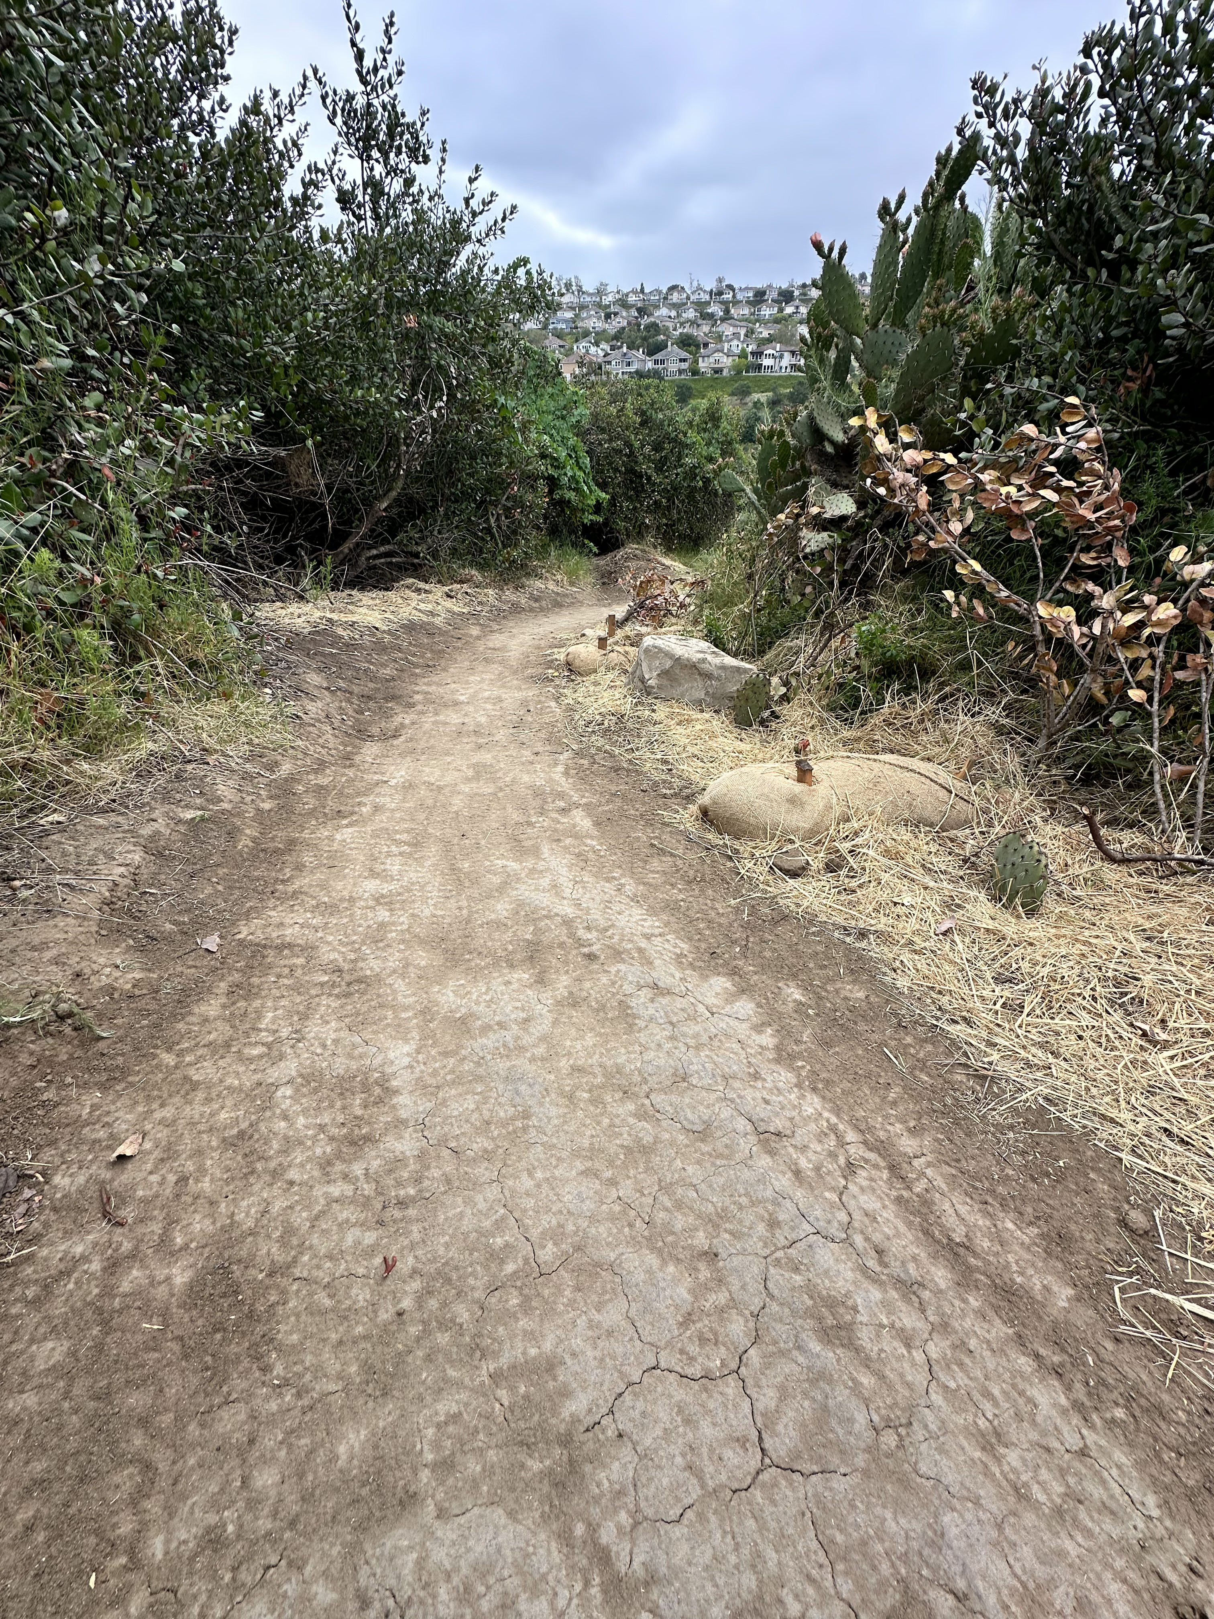
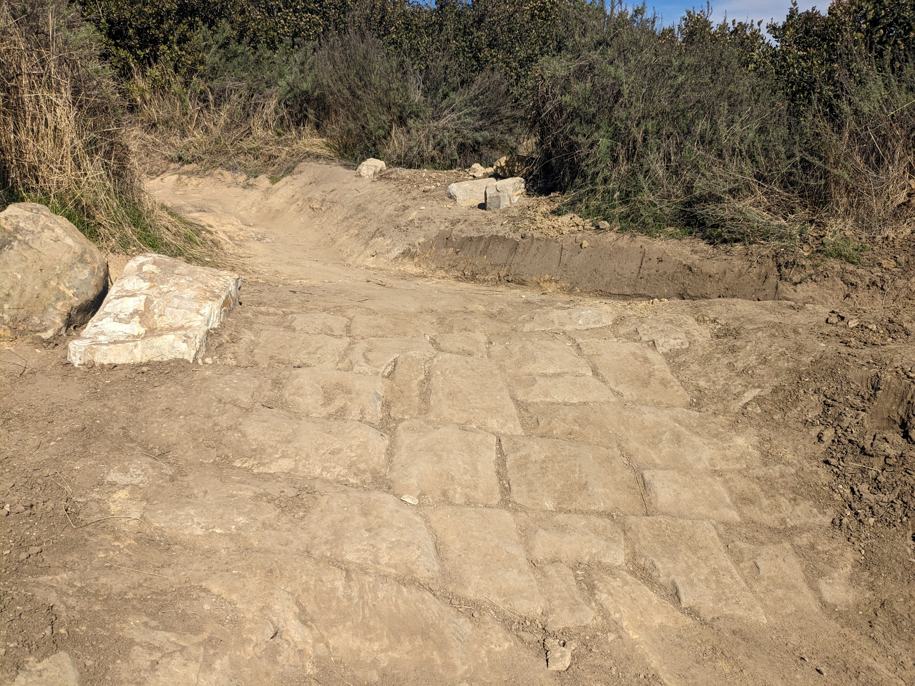
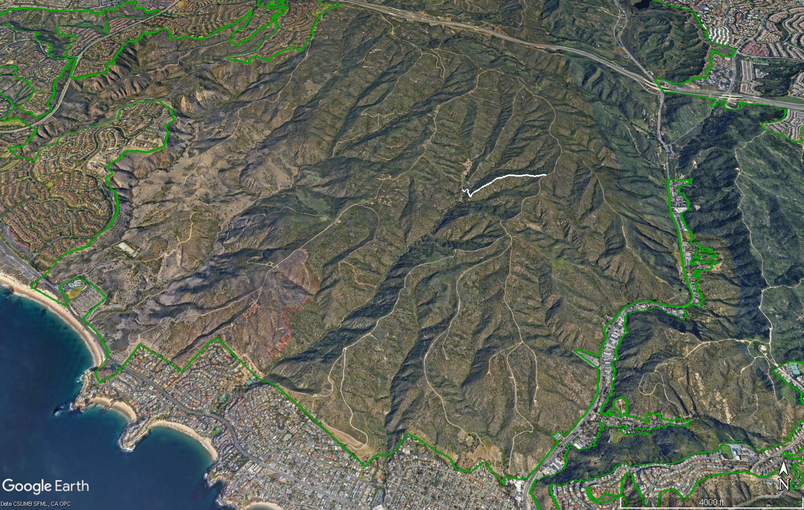
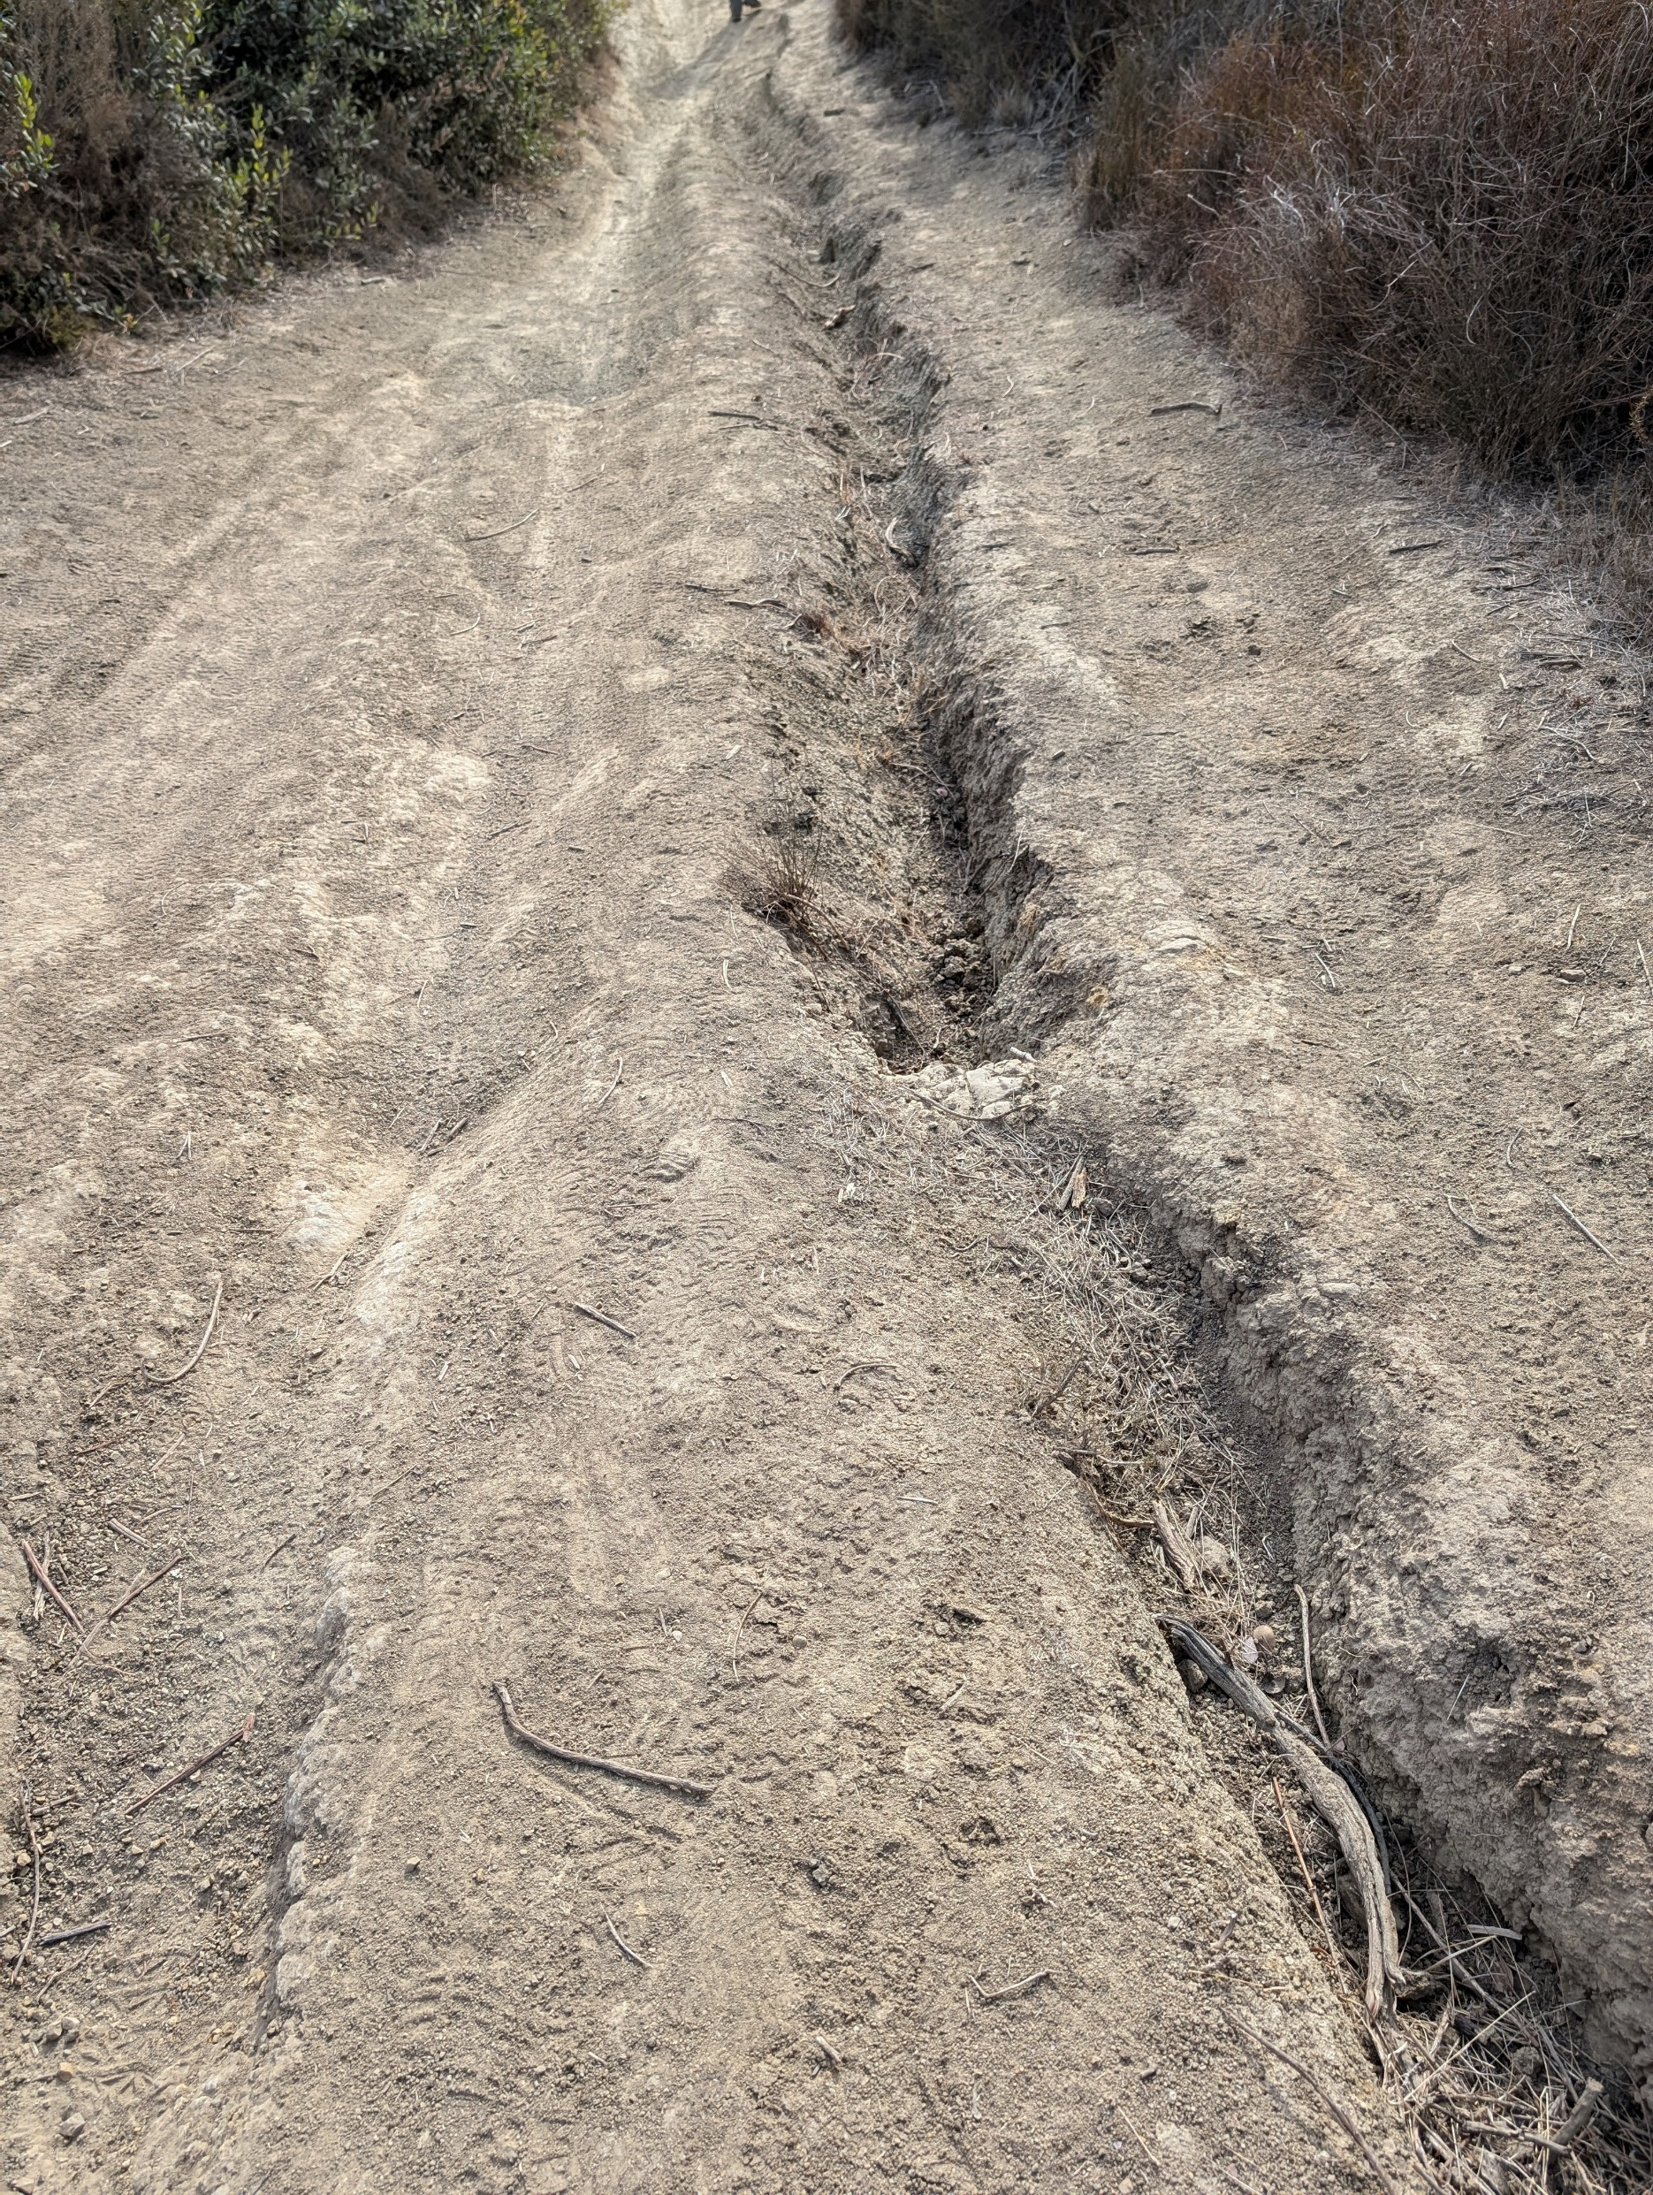
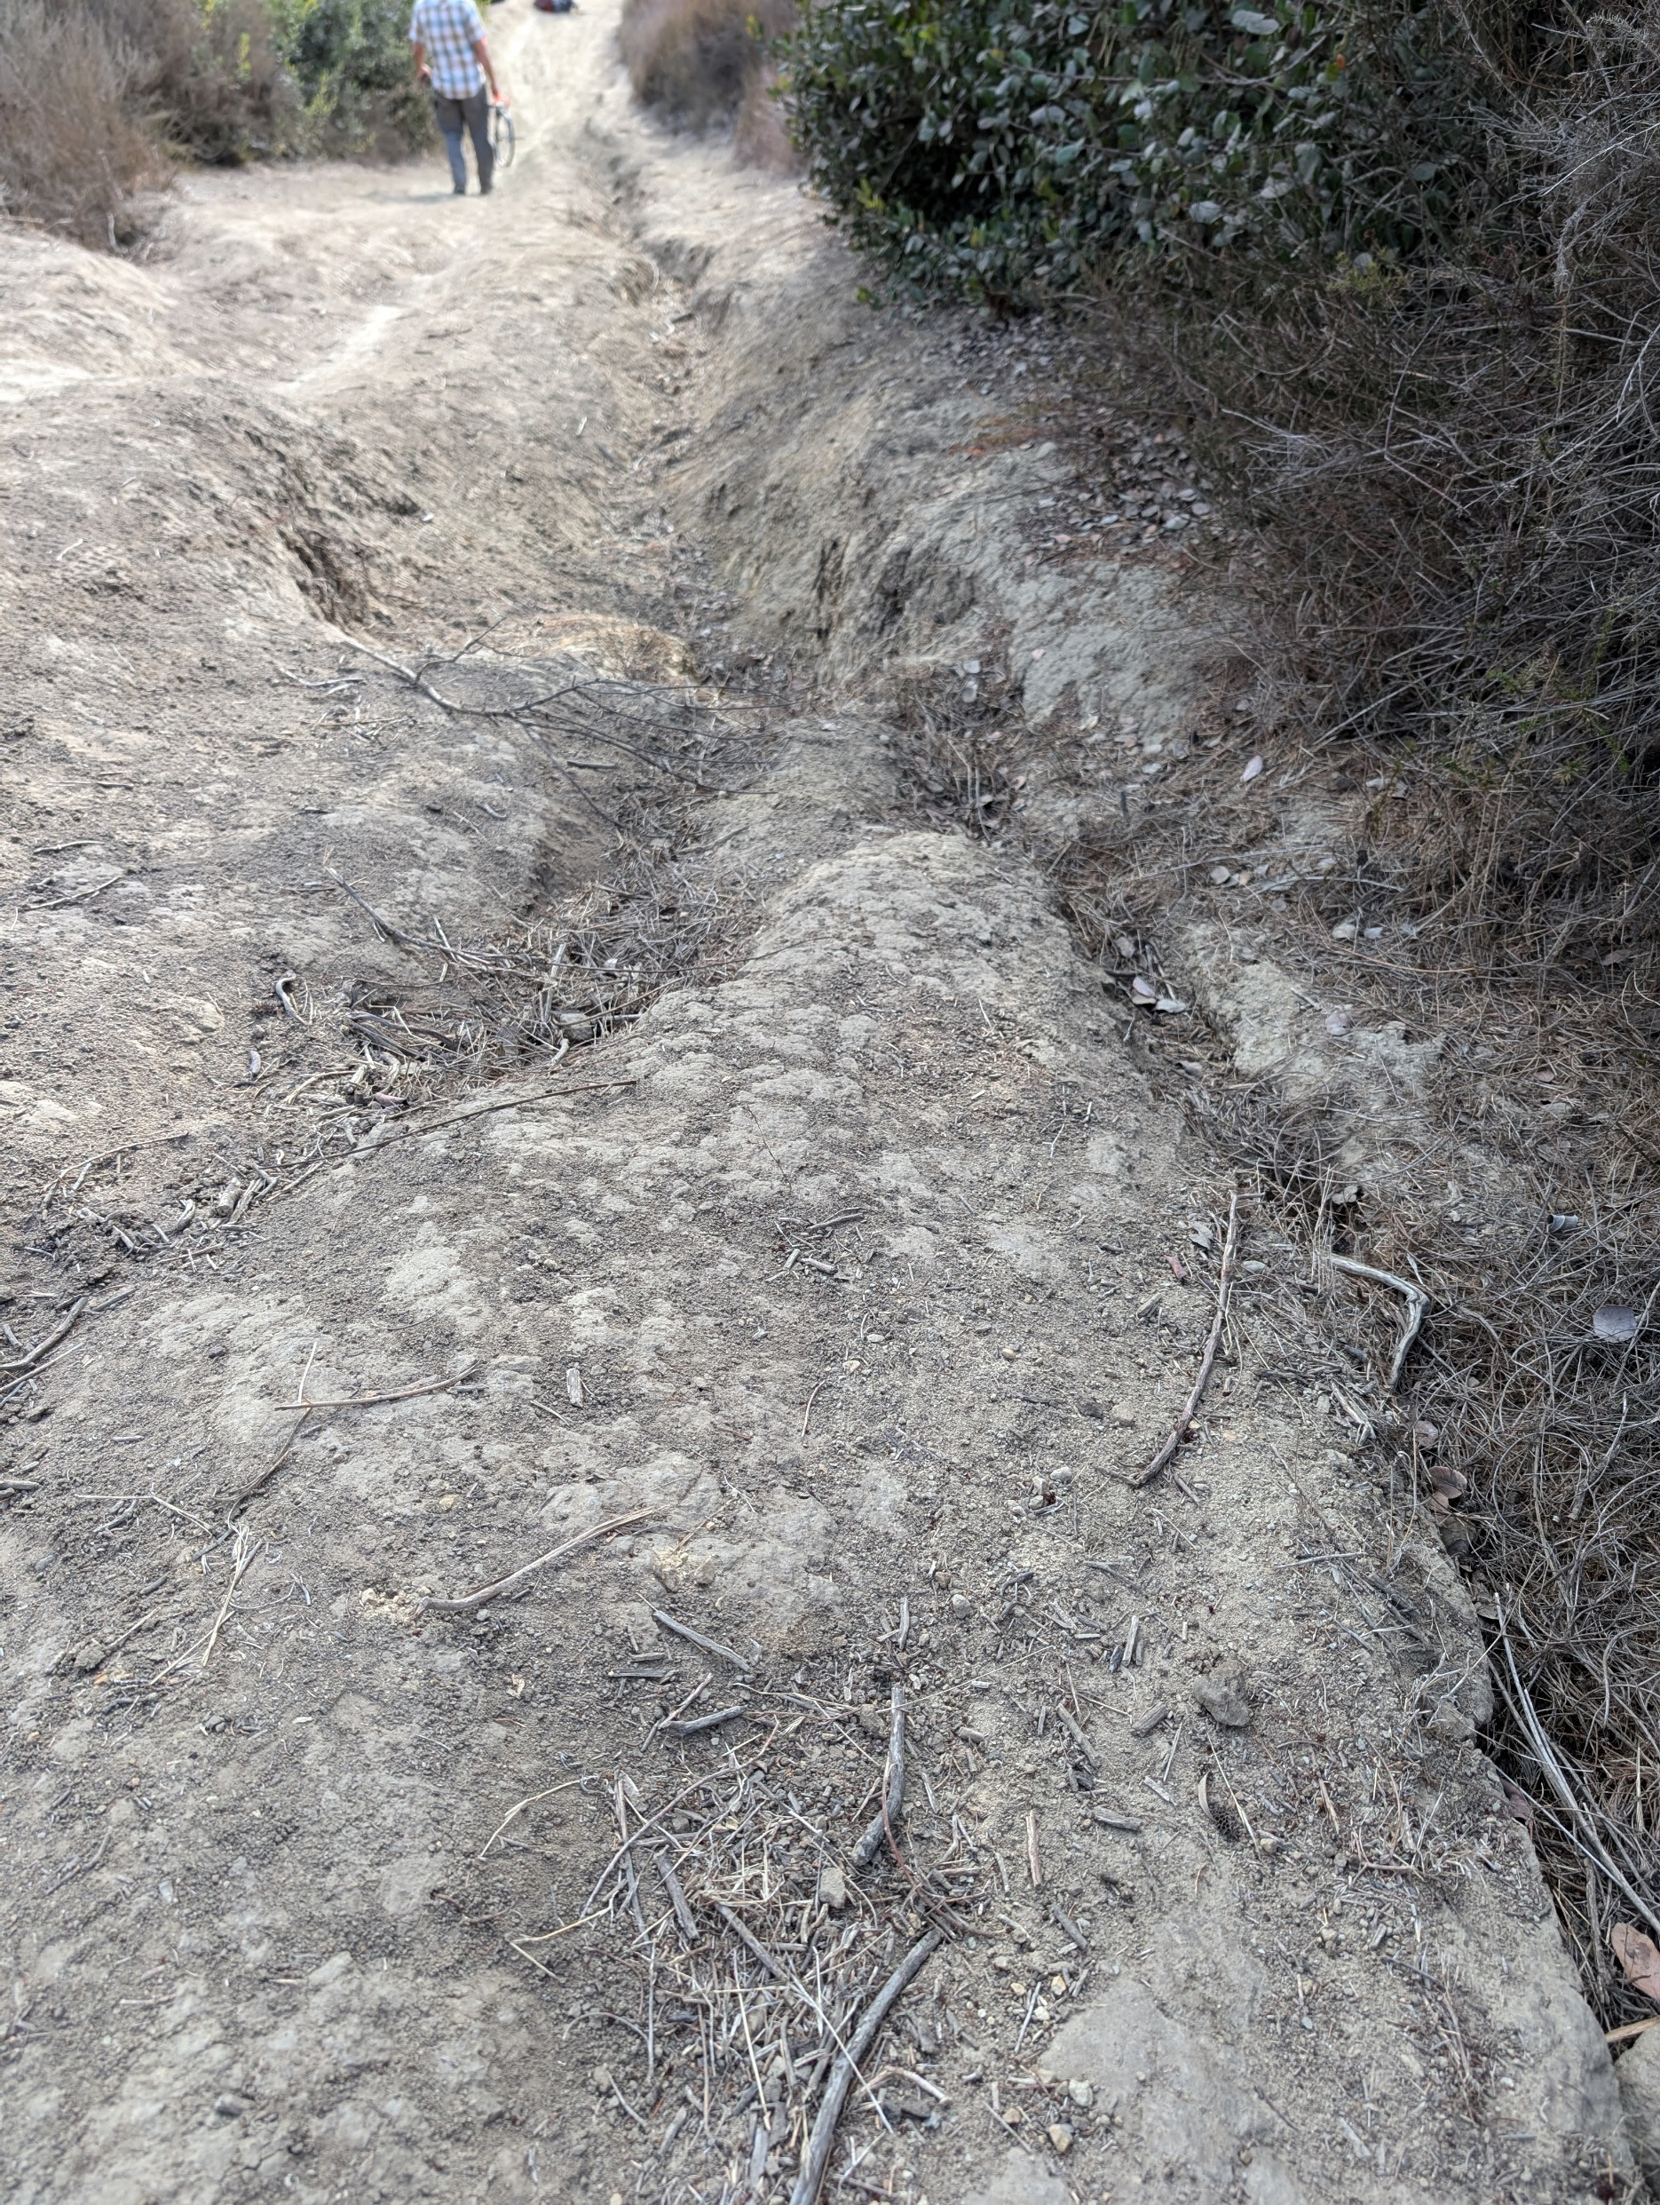
Trail in Need: Old Emerald
In 2025, LCF is raising funds to fix degraded parts of trail in the South Coast Wilderness
Donate Now button floats in place through scrolling. Clicking sends User directly to the Donate Now slide
Donate Now
Top of map is visible from first image
Millions of people visit the 22,000- acre South Coast Wilderness every year for hiking, mountain biking, bird-watching, and a peaceful break from busy city life
Donate Now
Trails Need You
Laguna Canyon Foundation has over a decade of experience caring for the trails in the South Coast Wilderness
Our projects transform problem areas like these on Cholla Trail…
Scrolling replaces text and inserts image
Donate Now
Before LCF trail repair
Scrolling replaces text and images
…Into sustainable, maintainable trail to last for decades
This year, Laguna Canyon Foundation has identified another trail in need
Donate Now
After LCF trail repair
Scrolling makes zoom in effect/fade transition from overhead view of whole South Coast Wilderness to angled view of Laguna Coast Wilderness with Old Emerald Trail centered
Old Emerald Trail runs down a steep, west-facing ridge in Laguna Coast Wilderness Park
Donate Now
Scrolling replaces text and inserts image
Rain and heavy visitor use combine on steep sections to cause major erosion and habitat loss
This trail needs more than regular maintenance to be sustainable
Note: Return to take new pictures. All areas more degraded than when these were taken in November.
Donate Now
Continue on next slide

Slide 2
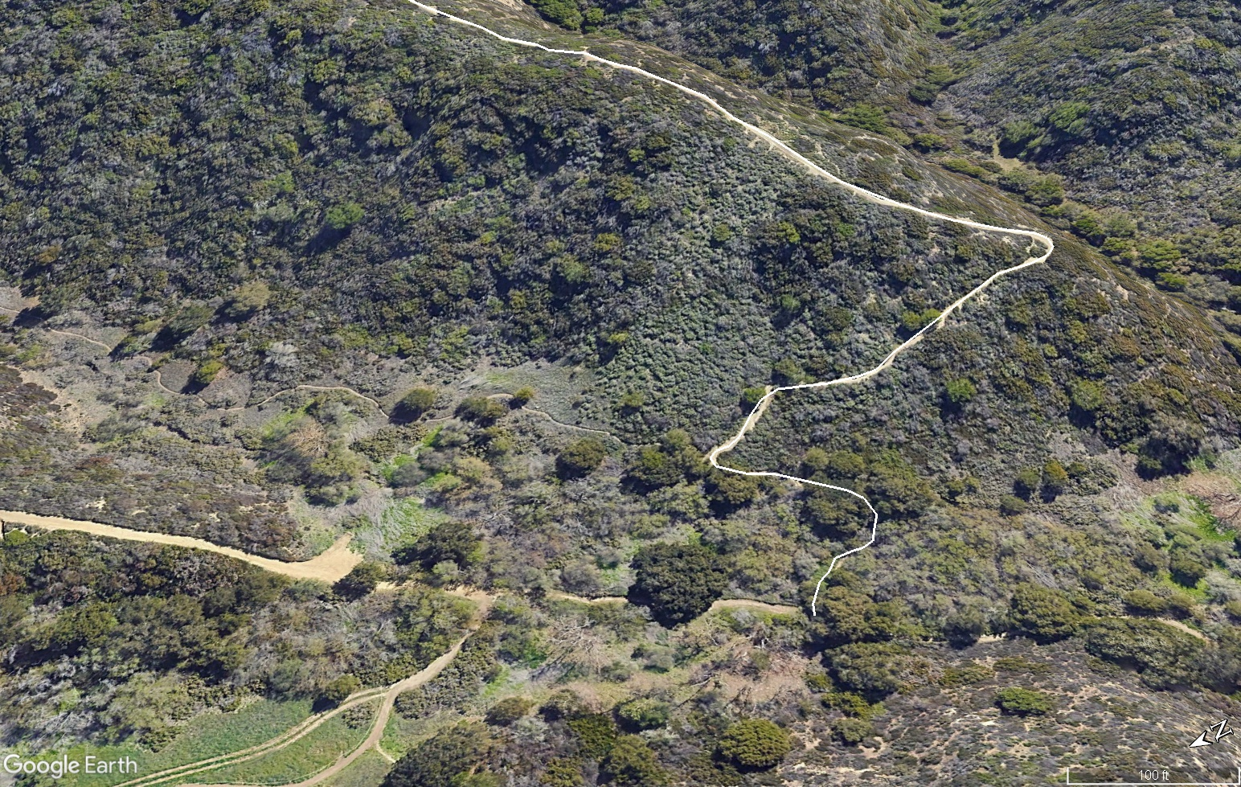

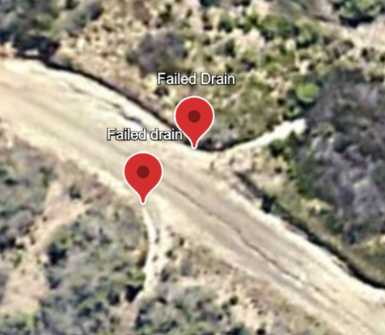
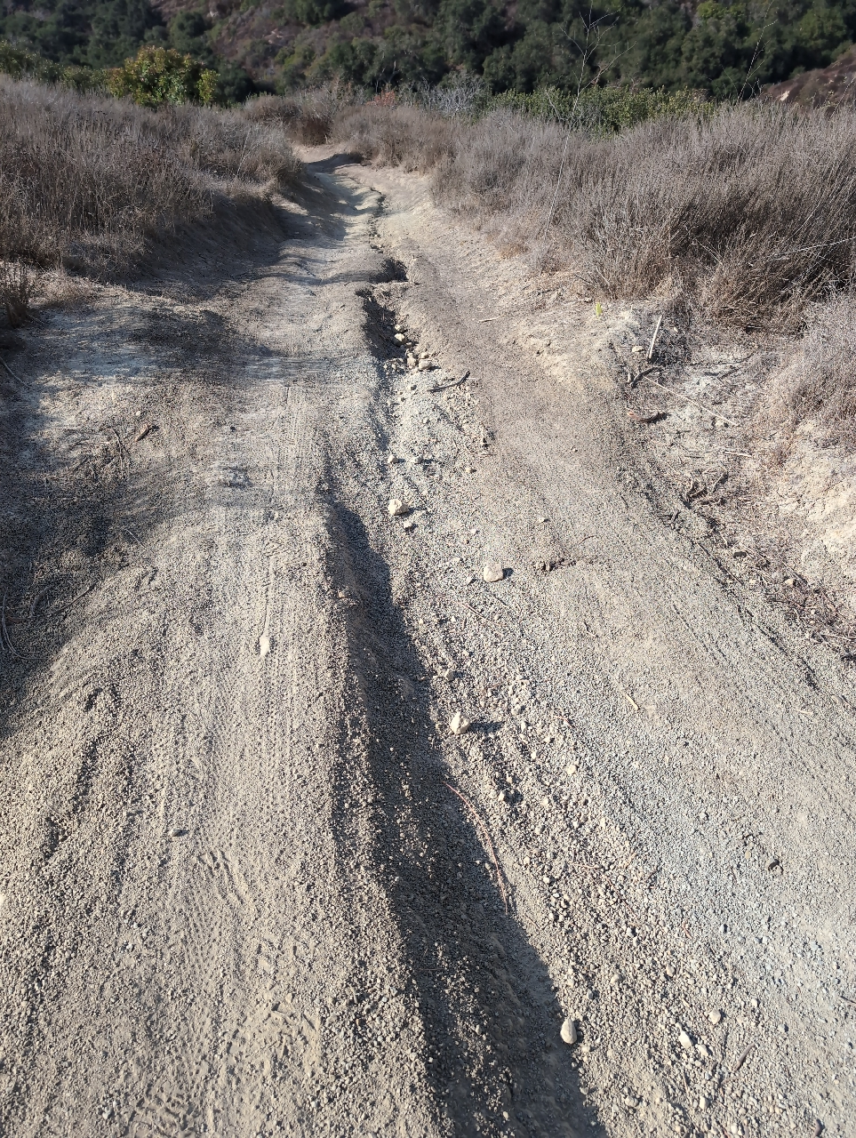
Rain and heavy visitor use combine on steep sections to cause major erosion and habitat loss
This trail needs more than regular maintenance to be sustainable
This is the same point in the web page journey as the bottom of the previous slide
Donate Now button floats in place through scrolling. Clicking it sends User straight down to the Donate Now slide
Donate Now
The lower 1100 feet of Old Emerald has steep sections with grades up to 27%
Scrolling zooms in to close up of Old Emerald project section
Donate Now
Trails Need You
Scrolling replaces text and inserts image
Laguna Canyon Foundation plans to install 10 sections of rock armoring to stabilize the tread and allow water to drain off the trail
Work Sections | 10
Total Area of Rock Armoring | 410 square feet
Total Area Improved | 3120 square feet
Donate Now
Scrolling replaces text and inserts image
Donate Now
Help Build Your Trails!
I want to give _______________ to the next section up for repair
Section B: $2,800 to goal
I want to sponsor a whole section
Section A: $3,067 Fully Funded!
Section B: $3,134
Section C: $8,048
Section D: $3,560
Section E: $5,123
Section F: $3,969
Section G: $4,149
Section H: $3,064 Fully Funded!
Section I: $3,936
Section J: $2,900
Donate Now Page: Clicking the Donate Now button on previous steps of the journey brings User to this slide
Click on a section letter to learn more
Click Here to read the full project proposal
To save space, could make the sponsor section selector a drop down menu
Either pdf download of project proposal or separate page
Donate
Clicking a section letter brings up an info page
Section A
Trail damage includes trenching down the middle and extreme widening.
LCF will install a large rock armored drain to channel water off the trail, repair the erosion, and naturalize the sides to provide new habitat.
Section | Distance from Lower Trailhead (ft) | Feature Type | Grade | Length | Width | Vegetation Removal (sq ft) | Naturalization Area (sq ft) | Estimated Days Per Section (3-5 LCF Staff)
A | 1154 | Drain |  | 6 | 8 |  | 30
A | 1064 | Armored drain | 24 | 8 | 10 | 10 | 250
A | 1064 | Tread repair |  | 108 | 5 |  |  | 5
Note: need better pictures to capture seriousness of issues.
Help Build Your Trails!
I want to give ________ to repair Section A
I want to fully fund Section A: $2,800 to goal
Donate
Return to full map

